Slide 1

Chapter 5
Management and Operations
Simon Hudson

Slide 2
Topics Covered
On-mountain operations
Off-mountain operations
  Ski lift operations
  Snowmaking
  Ski resort grooming
  Mountain safety
  Instruction
  Mountain hosts
  Access
  Property
  Restaurants
  Staffing

Slide 3
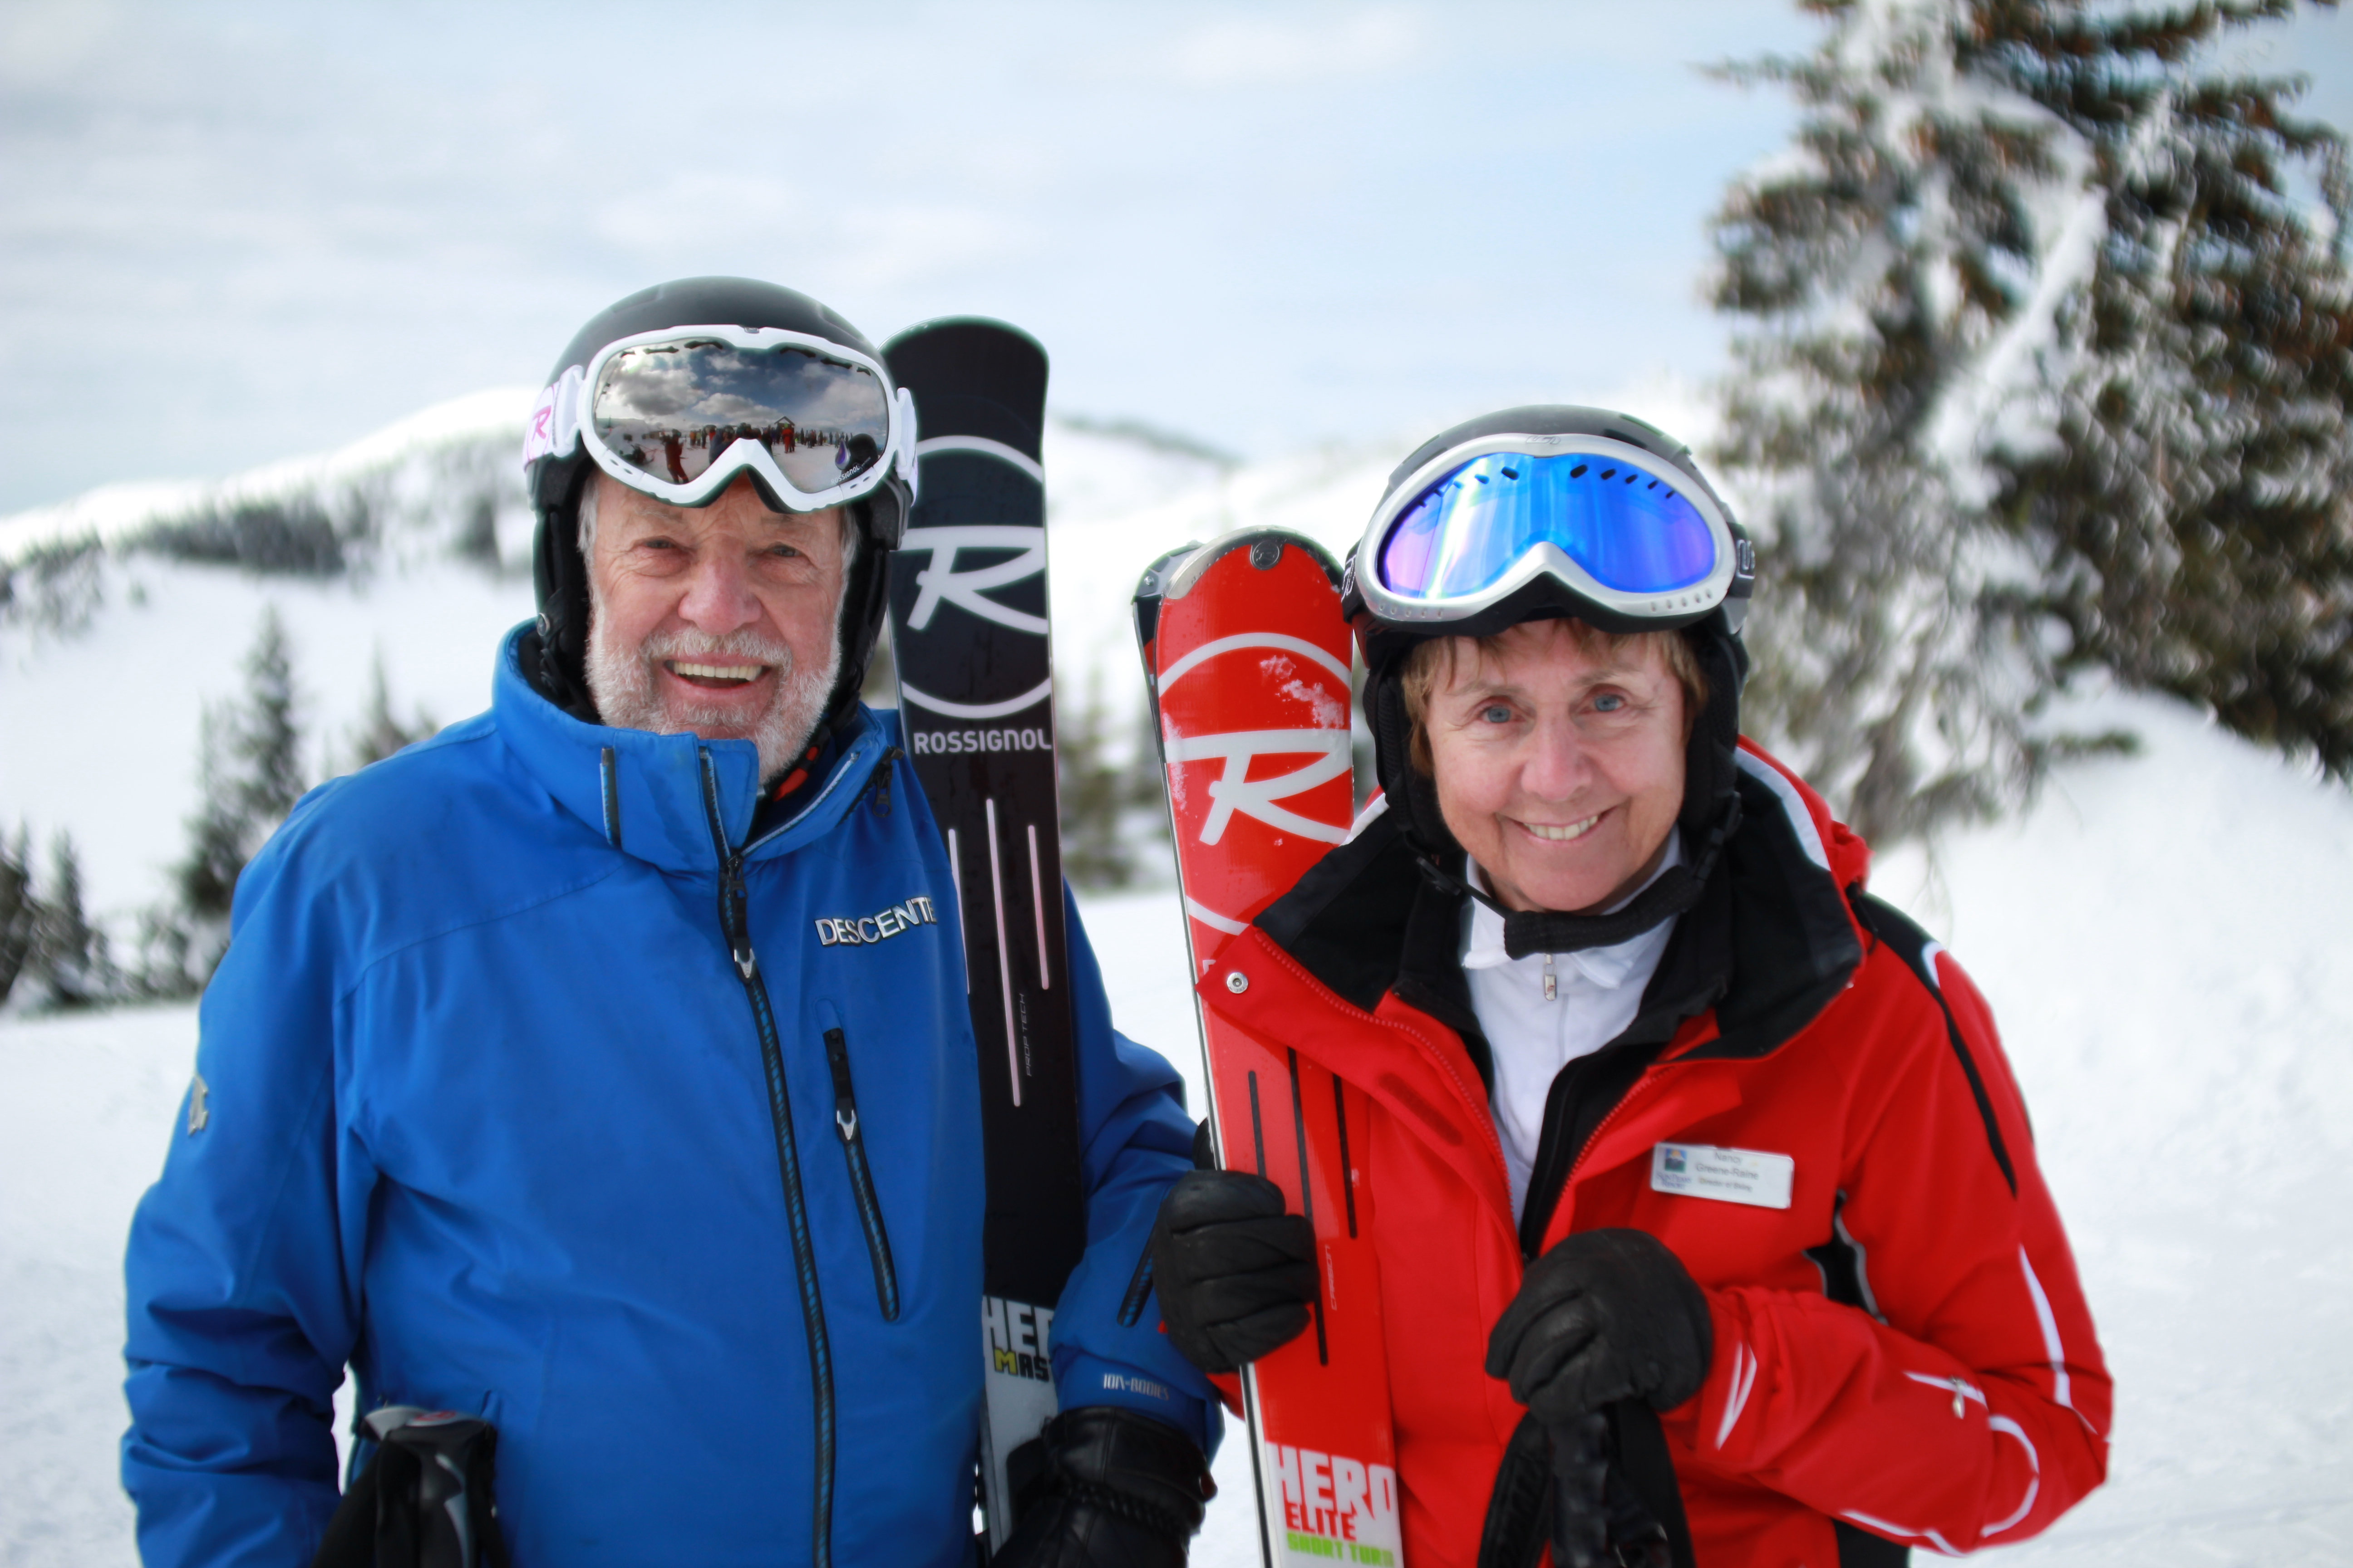
Spotlight: The quintessential ski couple
Al Raine and Nancy Greene Raine
“6, 8 and 10 rule” for a great ski vacation
Sun Peaks
  a full menu of activities
  four-seasons functionality
Al Raine and Nancy Greene

Slide 4
On-mountain operations
  Ski lift operations: an important element; invest in new and upgraded lifts
  Snowmaking
  Ski resort grooming: snowcats
  Mountain safety: programs to increase safety
  Instruction: upgraded lessons; apps
  Mountain hosts: guide

Slide 5
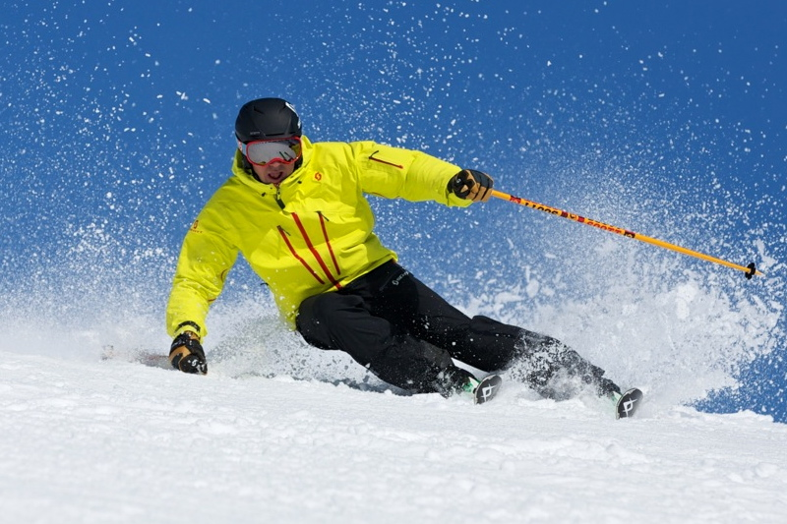
Profile: Portable ski instructor
The instructional ski app
Ski School Apps
The ski app could adversely affect ski instructor jobs

Slide 6
Off-mountain operations
  Access
    in and out of a resort
  Property
    own the skiers and own the mountain
  Restaurants
    service offering; ski with chef
  Staffing
    seasonal

Slide 7
Resort income at Vail (U.S.) and Whistler (Canada)
 | Vail Resorts | Whistler/Blackcomb
Tickets | 46% | 50%
Retail/Rental | 23% | 16%
Ski school | 11% | 11%
Dining | 9% | 13%
Other | 11% | 10%
Source: Adapted from Thompson, 2012

Slide 8
Intrawest real estate holdings in 2014
Resort | Parcels | Acres | Entitled Units | Value (m)
Steamboat | 5 | 27 | 640 | $51.0
Tremblant | 15 | 509 | 2,242 | $48.6
Winter Park | 21 | 95 | 962 | $23.5
Snowshoe | n/a | 359 | 1,464 | $18.0
Stratton | 7 | 161 | 200 | $9.2
Total Core Real Estate Holdings $150.3 m
Source: Adapted from Intrawest, 2014

Slide 9
Impact of winter sports in the U.S.
Industry | Winter Tourism Employment (thousands) | Labor Income ($ millions) | Value Added ($ millions)
Resort operations | 75.9 | $1,495.80 | $2,851.50
Dining (bars and restaurants) | 31.6 | $612.60 | $941.50
Accommodations | 17.6 | $558.90 | $1,035.10
Professional services | 8.4 | $659.00 | $779.80
Administrative support services | 8 | $257.80 | $296.10
Food & beverage stores | 5.2 | $148.70 | $214.70
Government | 4.6 | $307.90 | $358.70
General merchandise stores | 4.3 | $113.30 | $176.50
Real estate | 4.2 | $74.30 | $1,157.30
Health care | 3.6 | $239.80 | $255.60
Source: Adapted from NRDC, 2012

Slide 10
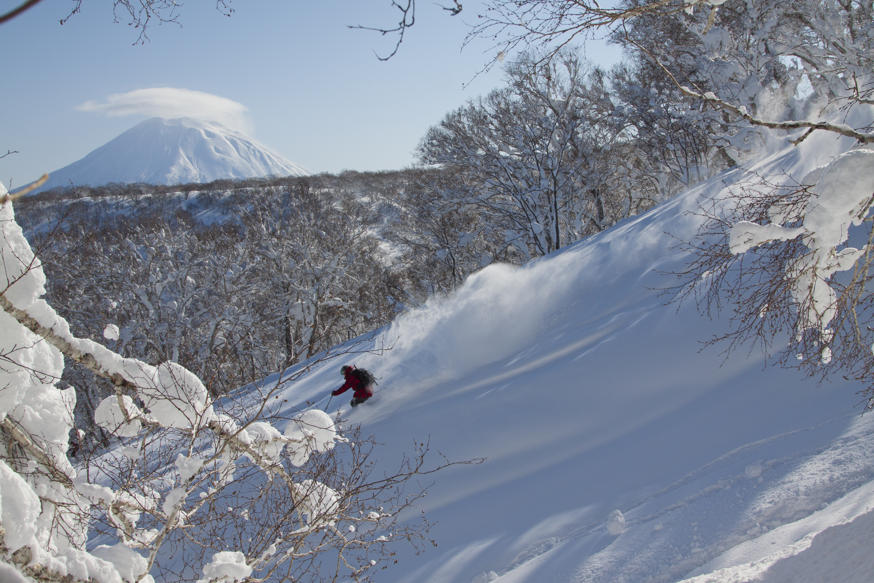
Case study:
Powder and property investment in Japan
Winter sports infrastructure and tourism is on the rise in Hokkaido
Inbound growth and growing interest from foreign investors
Property development
The Niseko United: an all-season resort

